Slide 1
Four Methods
Category | Description | Pros | Cons | Status
Virtualization Machine QEMU as a “System VM” | System-mode emulation: allows emulation of a full system, including processor and assorted peripherals | Standard catkin_make Not only compile but also run & test | Slow as real board. Potential risks:different between use ARM reference board “Versatile Express” and QC chipset. | Install ROS Compile ROS Camera sample APPs Verify on real ARM board Ready on Server
Container/chroot jail QEMU as a “Process VM | User-mode emulation: allows a (Linux) process built for one CPU to be executed on another | Standard Catkin_make | Fast | Install ROS Compile ROS Camera sample APPs Verify on real ARM board Ready on Server
Cross Compiler | A cross compiler is a compiler capable of creating executable code for a platform other than the one on which the compiler is running | Need include cross compile configuration in each project | Fast | Compile ROS Camera sample APPs Verify on real ARM board Ready on Server
OpenEmbedded | the build framework for embedded Linux. OpenEmbedded offers a best-in-class cross-compile environment. It allows developers to create a complete Linux Distribution for embedded systems. | support for many hardware architectures Good architecture and Drone project already use it . | Developers need to learn new concepts layer, recipes, classes … | Now can compile roscore

Slide 2
QEMU Overview
QEMU is a processor emulator and supports emulation of ARM, PowerPC, SPARC, x86, x86-64 and more. . QEMU has two operating modes:
User mode emulation: QEMU can launch Linux processes compiled for one CPU on another CPU, translating syscalls on the fly.
Full system emulation: QEMU emulates a full system (virtual machine), including a processor and various peripherals such as disk, ethernet controller etc.

Slide 3
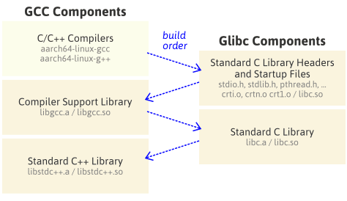
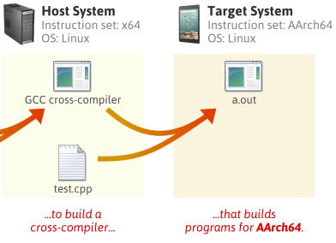
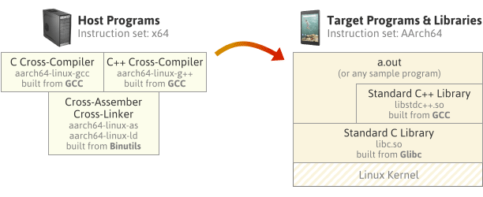
Cross-Compiler

Slide 4
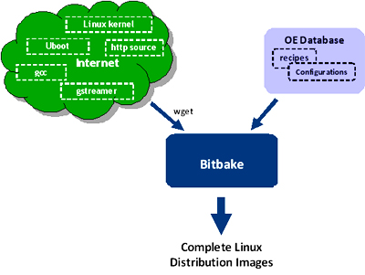
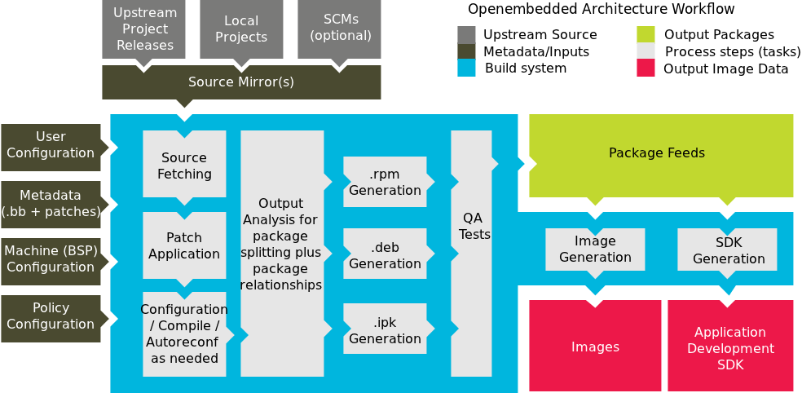
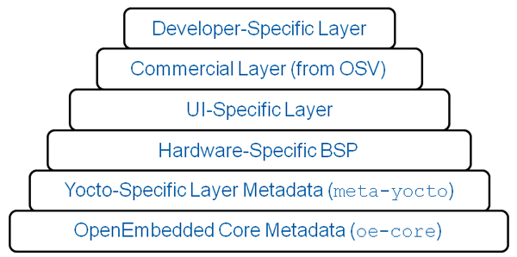
Open Embedded and bitbake

